Slide 1
VHDL - Tutorial

Slide 2
FPGA - FIELD-PROGRAMMABLE GATE ARRAY
Group of 8 logic cells
Memory block
Interconnection
wires

Slide 3
VHDL ?
Very High Speed Integrated Circuit Hardware Description Language
American Department of Defense “DoD”

Slide 4
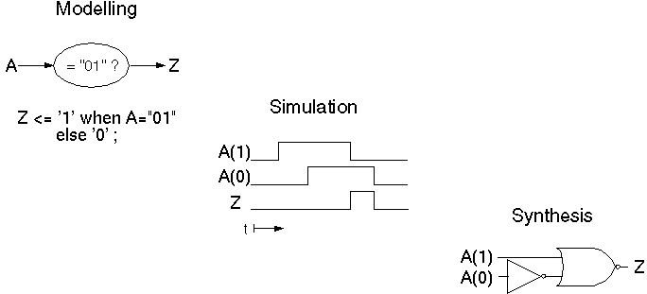
VHDL
Application of HDLs

Slide 5
VHDL - History
early `70s: Initial discussions
late `70s: Definition of requirements
mid -`82: Contract of development with IBM, Intermetrics and TI
mid -`84: Version 7.2
mid -`86: IEEE-Standard
1987: DoD adopts the standard -> IEEE.1076
mid -`88: Increasing support by CAE manufacturers
late `91: Revision ➔ Eu Comecei a Utilizar !
1993: New standard
1999: VHDL-AMS extension

Slide 6
VHDL - History
Hardware Description
x
Software Description

Slide 7
General
----------------------------------
-- Example VHDL Code --
----------------------------------
signal mySignal: bit; -- an example signal
MYsignal <= '0', -- start with '0'
'1' AFTER 10 ns, -- and toggle after
'0' after 10 ns, -- every 10 ns
'1' afTer 10 ns;
Case insensitive
Comments: '--' until end of line
Statements are terminated by ';'
(may span multiple lines)
Signal assignment: '<='
Variable assignment: ‘:='
User defined names:
  letters, numbers, underscores
  start with a letter

Slide 8

Entity
entity HALFADDER is
port(
A, B: in bit;
SUM, CARRY: out bit);
end HALFADDER;

Slide 9
Architecture
entity HALFADDER is
port(
A, B: in bit;
SUM, CARRY: out bit);
end HALFADDER;
architecture RTL of HALFADDER is
begin
SUM <= A xor B;
CARRY <= A and B;
end RTL;

Slide 10
Signal x Variable:
Paralelism
Signal:
  Parallel:
  A <= B;
  B <= A;
Variable:
  Sequential:
  Aux := A;
  A := B;
  B := Aux;

Slide 11
Variable Declaration
CONSTANT LOAD : STD_LOGIC_VECTOR (5 downto 0) := "110000";
SIGNAL PC :STD_LOGIC_VECTOR(15 downto 0); -- Program Counter
TYPE STATES IS (decode, exec, halted);
SIGNAL STATE :STATES;
TYPE REGISTERS IS ARRAY (0 to 15) OF STD_LOGIC_VECTOR(15 downto 0);
SIGNAL REG :REGISTERS;
VARIABLE RX : INTEGER;
RX := "0001“; ou RX := conv_integer(IR1(9 DOWNTO 6));
REG(RX) <= x"0000";

Slide 12
Math
AUX := X + Y;
AUX := X - Y;
AUX := X * Y;
AUX := CONV_STD_LOGIC_VECTOR(
CONV_INTEGER(X) / CONV_INTEGER(Y), 16
);

Slide 13
State Machine
PROCESS (clk, reset)
  VARIABLE RX : INTEGER;
  VARIABLE AUX :STD_LOGIC_VECTOR(15 downto 0);
BEGIN
  if (reset = '1') then
    REG(0) <= x"0000";
    State <= busca;
  elsif (clk'event) and (clk = '1') then
    CASE state IS
      WHEN busca=>
        state <= decodifica;
      WHEN decodifica=>
        state <= exec;
      WHEN exec=>
        state <= busca;
      WHEN OTHERS =>
        state <= busca;
    END CASE;
  end if;
END PROCESS;

Slide 14
State Machine
CASE state IS -- Case das Transições
  WHEN 0 =>
    Transições
  WHEN 1 =>
    IF (FL = ‘1’) THEN state <= 2; --Transicoes
    ELSE state <= 1;
  WHEN 2 =>
    . . .
  WHEN OTHERS =>
    state <= 0;
END CASE;
CASE state IS -- Case das Ações
  WHEN 0 =>
    Ações
  WHEN 1 =>
    buzina <= ‘1’; -- Acoes
  WHEN 2 =>
    . . .
  WHEN OTHERS =>
    buzina <= ‘0’; -- Acoes
END CASE;

